Slide 1
Political Background of the Independence, & the Indian Independence Act, 1947
March 2, 2022

Slide 2
Political Background of the Independence
Events of the 1940s that prompted the Independence of India in 1947:
The Lahore Resolution (1940) and its aftermath:
Cripps’ Mission, 1942:
Wavell Plan/ Simla Conference, 1945:
Cabinet Mission Plan, 1946:
The Mountbatten Plan, June 1947:
Indian Independence Act, 1947:

Slide 3
Political Background of the Independence of India
Cripps’ Mission, 1942:
Special mission of Sir Stafford Cripps to India (March 1942) during the tensions of WWII-
The creation of a new Indian Union- a Dominion (Federal Government).
Set up a constitution-making body, and sign a treaty between the His Majesty’s Government and the Constituent Assembly with an aim to complete transfer of powers from the British to the Indians.
The constitution-making body would be formed based on the electoral harvests of the provincial elections (to be held at the end of WWII) based on Proportional Representation (PR) system.
An interim government would be formed consisting of members of the major parties for effective conduct of the War, but the ‘Defence Department’ would be in the hands of the British government.
Right of any province to remain aloof from the proposed Union and make a separate treaty with the British (right of self-determination for every Province).
However, both the Congress and the Muslim League rejected the Cripps’ offers, and, thus, it failed.
Cripps’ blamed the Congress for the failure of the Plan.

Slide 4
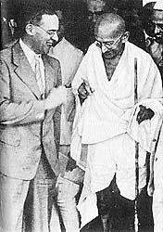
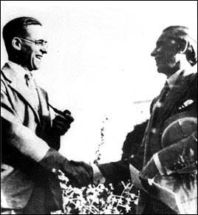
Gandhi & Jinnah with Sir Stafford Cripps

Slide 5
Political Background of the Independence of India
WAVEL PLAN- June, 1945 (Simla Conference):
The failure of Cripps’ Mission was followed by a period of silence till Lord Wavell became the Viceroy of India, and formulate a plan to solve the statehood problem acceptable to both the Congress and Muslim League.
The British government would give Constitutional Reform if all the political parties help the British in the War.
Viceroy’s Executive Council would be reconstituted with more representatives of organized political opinion.
13-member Executive Council, of which 5 must be Muslims. However, the Congress demanded to fill up some Muslim-seats-quota by Muslim Congress leaders.
This demand of the Congress was strongly objected by the Muslim League fueling huge controversy.
Low-caste Hindus, Shudras and Sikhs would be there in the Executive Council.
All members of the Council would be Indians except the Viceroy and the Commander-in-Chief.

Slide 6
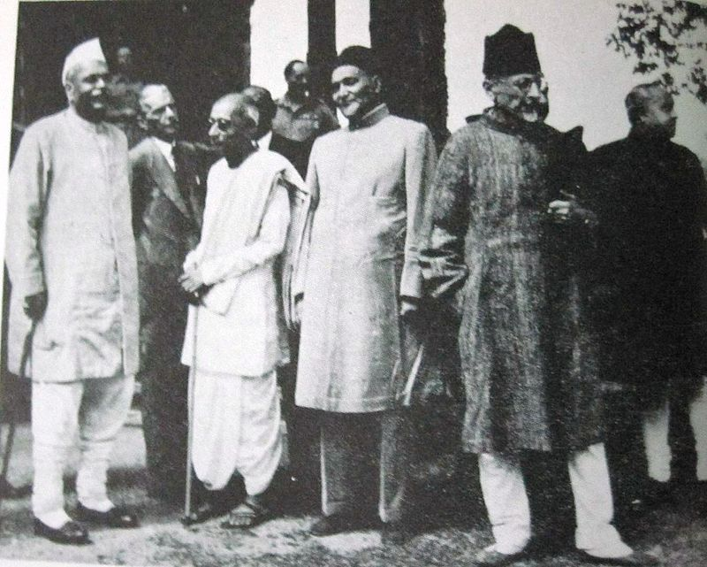
Indian Leaders at Simla Conference

Slide 7
Political Background of the Independence of India
THE CABINET MISSION PLAN, 1946 (last effort to have United India):
In March 1946 a Mission consisting of three British cabinet members, namely Lord Pethick Lawrence, A. V. Alexander and Sir Stafford Cripps came to India “to help her to attain her freedom as speedily as possible.” Lord Lawrence headed the mission.
They along with the Viceroy tried their utmost to assist the main political parties to reach an agreement on the structure of the future government of this sub-continent. Their attempt, however, failed, although they put forward a Plan in May 16 which proposed-
A united Dominion of India would be given independence.
Provinces would be grouped into three groups. Bengal and Assam would form “group C.” Muslim majority Sind, Punjab, North West Frontier Province would form “group B.” The remaining areas of India would constitute “group A.”
The Central Government in Delhi would be empowered to handle defense, currency, communications and diplomacy.
There would be a Constituent Assembly to frame a constitution for the Union, and for the Groups and Provinces (long-term schemes).
There should be formed an Interim Government at Center (short-term scheme).

Slide 8
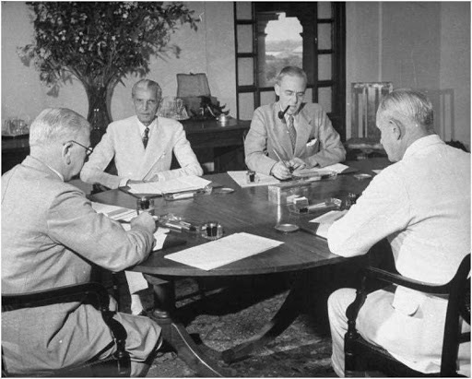
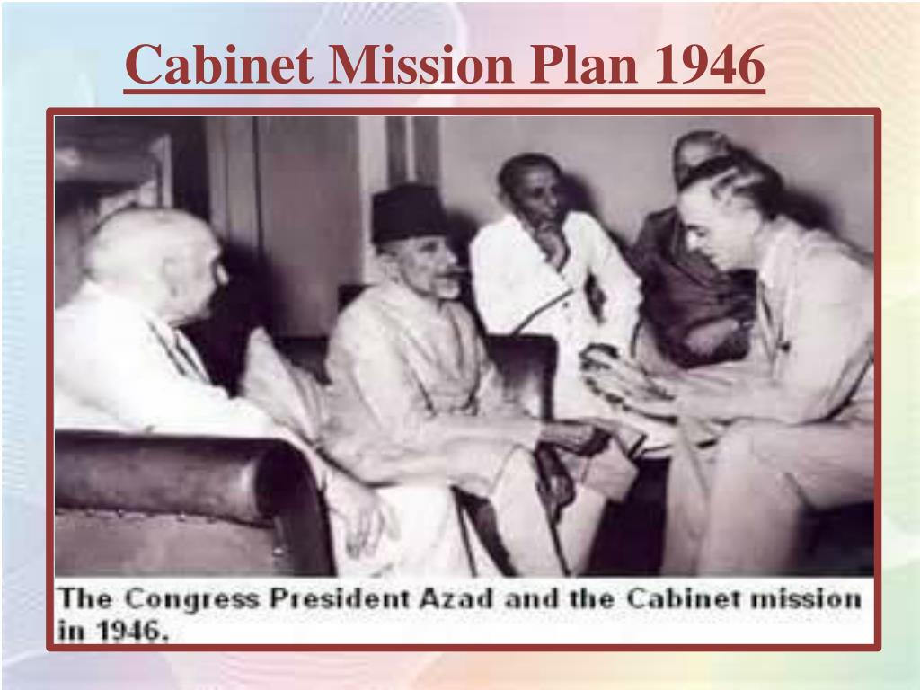
The Cabinet Mission with Jinnah (ML) and A K Azad (Congress)

Slide 9
Political Background of the Independence of India
Reactions of the Muslim League and Congress:
The Muslim League first accepted the Cabinet Mission Plan in its entirety considering ‘the group-system, constitution making power of the provinces and autonomous status of the provinces’ positive for them.
The Congress accepted the long-term proposals of the scheme, but rejected the short-term scheme raising a confusion upon the next course of action by the government headed by Viceroy Lord Wavell.
Earlier declaration of government to invite the accepting party to form the Interim Government, if both the parties do not agree on, ushered hope among the Muslim League.
Surprisingly Wavell did not invite Muslim League (because of the opposition of the Congress) to form government, and this compelled the Muslim League to reject the Cabinet Mission Plan, and demand for full sovereign Pakistan.
This shattered the last hope of united India. The Cabinet Mission Plan wanted to keep united India, but its proposed ‘group-system,’ in fact, contains the “seeds of Pakistan.”

Slide 10
Political Background of the Independence of India
The Interim Government:
Revision of Congress’s former decision and acceptance of the Interim Government Proposal.
Congress formed the Government (Pundit Nehru) initially with dire opposition of the Musalmans. Muslim League joined it later on upon the persuasion of Lord Wavell.
Dysfunctionality of the Interim Government, rise of communal hatred (ref. The Great Calcutta Killings, August 16, 1946; Direct Action Day of the League) made the British authority to make the “February Declaration” on February 20, 1947: The British Government declared that before June 1948, they would quit India by transferring powers to appropriate authority/ authorities.
Continued disagreements between the Congress and Muslim League, and finally League’s boycott of the Constituent Assembly created further troubles proving the cabinet Mission Plan a failure.

Slide 11
Political Background of the Independence of India
THE MOUTBATTEN PLAN (The Plan of June 3), 1947
Envisaged the transfer of powers to two Constituent Assemblies- one for Pakistan and the other for India.
A new plan on the basis of the recognition of Pakistan which the Congress also accepted.
A boundary commission (Radcliffe Commission) was formed for demarcation purposes.
The Mountbatten Plan (envisaged the partition of the Sub-continent and transfer power to two sovereign constituent assemblies) was fundamentally different from the Cabinet Mission Plan (which proposed for an united India).

Slide 12
The Indian Independence Act, 1947
INDIAN INDEPENDENCE ACT, 1947
To give effect to the “Plan of June 3,” the British Parliament passed an Act known as the “Indian independence Act 1947” on July 18, 1947.
The Bill was introduced in the British Parliament on July 4 1947, received the Royal Assent on July 18 1947.
The Act was designed by the Prime Minister Clement Attlee as Indian Political Parties after long bargaining agreed on the transfer of power from the British Government.
The Act was the legislation passed and enacted by the British Parliament that officially declared the Independence of India partitioning British India into two separate and independent states.

Slide 13
INDIAN INDEPENDENCE ACT, 1947
Salient Features:
The Act provided for the creation of two independent Dominions: India and Pakistan.
It provided for the complete cessation (end) of British control over Indian Affairs from August 14, 1947.
Creation of two Constituent Assemblies (all power be vested in the constituent Assemblies) for the two Dominions having sovereign power of law-making and frame their own constitutions in ways they might decide.
Until the new constitution were framed and put in operation, the Governments of Pakistan and India would be carried on according to the Indian Act of 1935, subject to some modifications.
For each Dominion a Governor General (GG) would be appointed by the King, and the GG would appoint provincial governors on advice of the Cabinet of the concerned Dominion.
The Constituent Assemblies would perform as Central Legislatures.
Both the Dominions were given full right to decide whether to remain within the British Commonwealth of nations, or to come out of it.

Slide 14
INDIAN INDEPENDENCE ACT, 1947
Salient Features(Contd…)
A Boundary Commission headed by Cyril Radcliff was to determine the boundaries of the two Dominions.
Punjab and Bengal were to be divided.
Bengal to be known as E. Bengal and W. Bengal.
Sylhet was to decide by referendum.
The Princely states could decide where to join.
The title of ‘Emperor of India’ was dropped from the British Crown’s titles, and the post Secretary of India was abolished.
Thus, almost 200 years “Colonial Regime” ended in the Indian sub-continent.

